Slide 1
stream editor (sed)

Slide 2
sed scans the input file, line by line, and applies a list of instructions(sed script) to each line in the input file.
the script ,which is usually a separate file, can be included in the sed command line if it is a one line command
it does not change anything in the original file

Slide 3
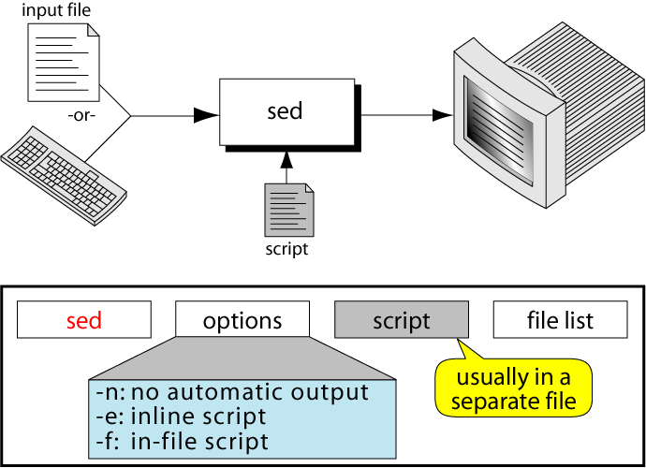
The sed command

Slide 4
sed script
sed requires one or more instructions that provides the editing criteria
when there is only one command, it may be entered from the keyboard
mostly instruction are placed in a file(sed script)
each instruction in a sed script contains an address and a command

Slide 5
sed script format
instructions included in command line
sed -e ‘address command’ input _file
instructions placed in a file
sed –f script.sed input _file
create script file using text editor
save file with .sed extension

Slide 6
instruction format
address command
each instruction consists of address and command
address select the line to be processed by the command
! is optional .select the non matching line
command indicates the action that sed is to apply to each input line that matches the address

Slide 7
comments
ignored by sed
starts with #
if comment requires more than one line, each line must be start with a comment token.

Slide 8
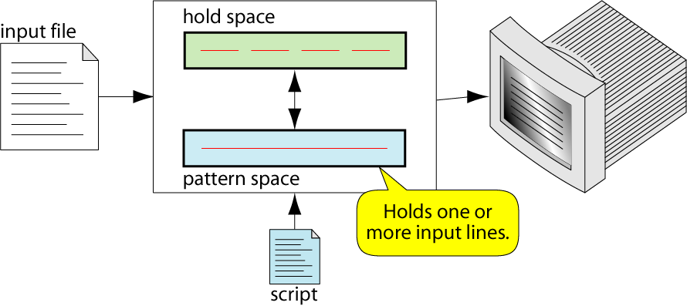
sed Operation

Slide 9
sed operation
each line in the input file is given a line number by sed
this number is matched against the address
copies an input line to the pattern space
applies all the instructions in the script, one by one, to all pattern space lines that match the specified address in the instruction
copies the content of the pattern space to the output file unless directed not to by the -n option flag

Slide 10
input file (hello.dat)
hello friends
hello guests
hello students
script file (hello.sed)
1,3 s/hello/greetings
1,3 s/friends/buddies
sed –f hello.sed hello.dat

Slide 11
Addresses
An address in an instruction determines which line in the input file are to be processed by the commands
if the address is missing, it means all the lines in the input line
Address in sed can be any one of the four types
Single Line Address
Set of Lines address
Range address
Nested Address

Slide 12
Single Line Address
specifies only one and only one line in the input file
two single line formats
a line number
dollar sign($)- specifies the last line
Eg
sed ‘1 =‘ file1
sed ‘2 d’ file2

Slide 13
Set of Line Address
set of line address is a regular expression that may match zero or more lines, not necessarily consecutive, in the input file
regular expression is written between two slashes
any line in the input file that matches the regular expression is processed by the command.
Eg
sed –e ‘/^o/=‘ file1
sed –e ‘/^A/d’ file2

Slide 14
Range Address
An address range specifies a set of consecutive lines
format is start address, comma with no space, and end address
when a line in the pattern space matches a start range, it is selected for processing
each input line is processed by instruction’s command until stop address matches a line
if some future line again matches start range, the range is again active until a stop address is found

Slide 15
Eg
line number, line number
line number,/regular expression
/regular expression/,line number
/regular expression/,/regular expression/
sed –e ‘1,3 s/hello/greetings’ file1
sed –e ‘/^A/,/B$/ s/hello/greetings’ file1
sed –e ‘1,$ d’ file1

Slide 16
Nested Address
address that is contained in another address
outer address must be either a set of lines or an address range
nested address may be either a single line, a set of line or range
20,30{
/^$/d
}
/hello/{
/hai/d
}

Slide 17
Commands
25 commands can be used in instruction
grouped them in to 9 categories based on how they perform their task .
line number command
modify commands
substitute command
transform command
input/output commands
file commands
branch command
hold space commands
quit

Slide 18
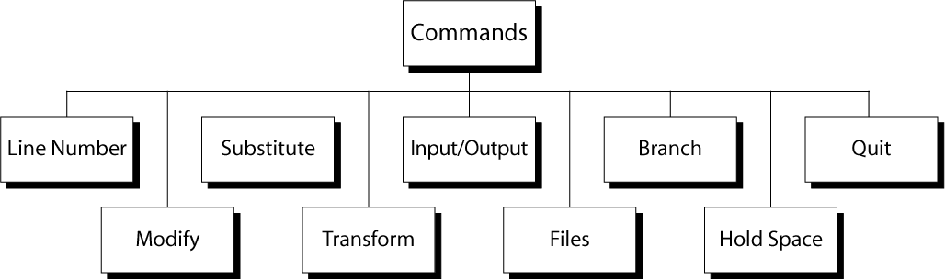
sed commands

Slide 19
1. Line number command (=)
put line number at the beginning of the line
line number is written on a separate line
Eg
sed “=” file1
sed “/^o/=“ file1

Slide 20
2. modify commands
commands are used to insert, append, change ,or delete one or more whole lines
The modify command require that any text associated with modify command be placed on the next line in the script
therefore the script must be in a file
all modify command apply to the whole line
cannot modify just a part of a line

Slide 21
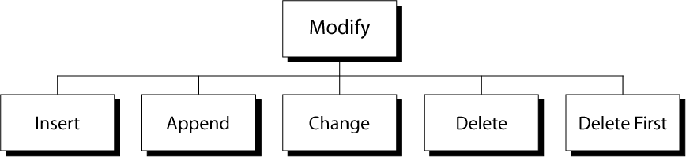

Slide 22
a)insert command(i)
adds one or more lines directly to the output before the address
can be used with single line and set of lines
cannot be use with a range
Eg
insert.sed
1i\
hello
sed -f insert.sed input_file

Slide 23
b)append command(a)
writes the text directly to the output after the specified line
append cannot be used with a range address
append.sed
1a\
hello
sed -f append.sed input_file

Slide 24
c)change command (c)
replaces a matched line with a new text
accepts all address types
change.sed
2c\
hello
sed -f change.sed input_file

Slide 25
d)delete pattern space command(d)
deletes the entire pattern space
sed ‘/^o/d’ input_file
e)delete only first line command(D)

Slide 26
3)substitute command (s)
replaces text that is selected by regular expression with a replacement string
similar to find and replace
address s/ pattern/replacement string/flag(s)

Slide 27
input file
mary had a white cat and a black cat
sed ‘1 s/cat/dog/’ input file
output
mary had a white dog and a black cat

Slide 28
substitute flags
global flag(g)
substitute command only replaces the first occurrence of a pattern
if there are multiple occurrences , none after the first are changed

Slide 29
input file.dat
mary had a white cat and a black cat
sed ‘1 s/cat/dog/g’ input file
output
mary had a white dog and a black dog

Slide 30
specific occurrence flag
specific occurrence substitution (digit) changes any single occurrence of text that matches the pattern
the digit specifies which one to change

Slide 31
sed ‘1 s/cat/dog/2 ‘ input_file
input
steve had a black cat, a yellow cat, and a white cat
output
steve had a black cat, a yellow dog, and a white cat

Slide 32
print flag (p)
helps to view only the lines that have been changed
to view only the lines that have been changed, turn off the automatic printing, done by –n option
once the automatic printing is turned off, we can add a print flag to the substitution command
sed -n ‘s/linux/unix/p’ input_file

Slide 33
write flag (w)
write the changed lines to a file
one space between the command and file name
sed -n ‘s/linux/unix/w filename’ input _file

Slide 34
4)transform command(y)
transform one set of characters to another set
each character in the first string represents a value to be changed to its corresponding characters in the second string
sed ‘y/aeiou/AEIOU’ input_file

Slide 35
5) I/O Commands
sed automatically reads text from the input file and writes data to standard output
I/O commands allows the user to control the input and output

Slide 36
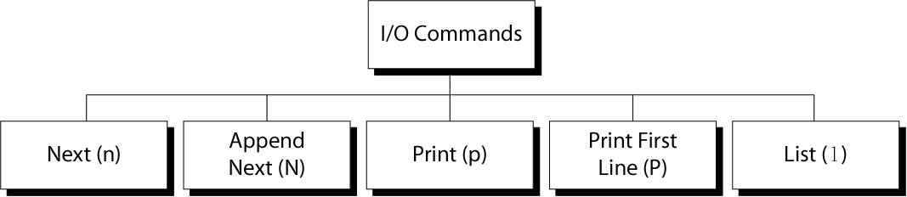

Slide 37
next command (n)
Forces sed to read the next input line
Copies the contents of the pattern space to output
Deletes the current line in the pattern space
Refills it with the next input line
Continue processing
/^[0-9]/{
n
/^a/d
}

Slide 38
append next command (N)
it adds the next input line to the current contents of the pattern space
useful when we need to apply patterns to two or more lines at the same time
/^[0-9]/{
N
/^a/d
}

Slide 39
print command (p)
copies the current contents of the pattern space to the monitor
if there are multiple lines in the pattern space, they are all copied
contents of the pattern space are not deleted by print command
/^[0-9]/{
n
/^a/p
}

Slide 40
print first line command(P)
prints only the first line of the pattern space
/^[0-9]/{
N
/^a/P
}

Slide 41
List command (l)
shows special characters (e.g. tab, etc)
SYNTAX
sed –n l ipfile

Slide 42
6) File Commands
allows to read and write from/to file while processing standard input
read:
address r filename
write:
address w filename

Slide 43
Read File Command (r)
Syntax: address r filename
reads a file and places its contents in the output before moving to the next command
it is useful when you need to insert one or more common lines after a text in a file
the contents of the file appear after the current line(pattern space) in the output
sed -f script.sed inputfile

Slide 44
script.sed
1 r hai.dat
hai.dat
what is your name
inputfile
hello how are you
where are you from

Slide 45
Write File Command
Syntax: w filename
write the contents of the pattern space to a file
/unix/ w filename

Slide 46
7) Branch Commands
Change the regular flow of the commands in the script file
allow to skip one or more commands in the script file
Branch label
Each branch command must have a target, either a label or the last instruction in the script
If “label” is supplied, execution resumes at the line following :label; otherwise, control passes to the end of the script
:mylabel
Can be up to 7 characters
Must be on a line by itself
Must begin with a colon
No spaces after it and after the colon

Slide 47
two branch commands
branch command(b)
branch on substitution(t)

Slide 48
branch command (b)
consists of an address, the command (b) and the target that can be used to branch to the end of script or to specific location within the script
The target must be blank or match a script label in the script
If no label is provided, the branch is to the end of the script, at which point the current contents are copied to the output and the script is repeated for the next input line

Slide 49
branch on substitution (t)
branch only if substitution has been made
also known as test command

Slide 50
Hold Space Commands
temporary storage area
used to save the contents of the pattern space
5 commands that can be used to move text back and forth between the pattern space and the hold space:
h, H
g, G
x

Slide 51
Hold Commands: h and H
The hold and destroy command (h) copies the current contents of the pattern space to the hold space and deletes any text currently in the hold space
The hold and append command (H) appends the current contents of the pattern space to the hold space

Slide 52
The Get Commands: g and G
The get and destroy command (g) copies the text in the hold space to the pattern space and destroy any text currently in the pattern space
The get and append command (G) appends the current contents of the hold space to the pattern space

Slide 53
exchange command (x) swaps the text in the pattern and hold spaces

Slide 54
9) Quit (q) Command
Syntax: [addr]q
Quit (exit sed) when addr is encountered.
Example: Display the first 50 lines and quit
% sed -e ’50q’ datafile

Slide 55
grep and sed
use sed instead of grep to find lines that matches a regular expression
use print (p) command in sed and turn off the automatic output option(-n)
grep ‘regular expression’ file1
sed -n ‘/regular expression/p’ file1

Slide 56
line that do not match a regular expression
use sed instead of grep to find lines that do not match a regular expression
grep -v ‘regular expression’ file1
sed -n ‘/regular expression/!p’ file1

